Slide 1
The Business of You: 10 Steps to Run Your Career Like a Business
Jon Kruger
(@JonKruger)
Notes:
As developers, we love to talk about technology. We love to talk about frameworks and design patterns and things like that. But there's a lot more to being a software developer than technology.
This is a talk about your career. Your job is a big part of your life. We all have an idea of what we want to get out of our job and career, so what can we do to get there? What things could prevent us from succeeding?
This is a talk about you. About what you like, what you're passionate about, what you want to do with your life. About finding a purpose in life greater than yourself and investing your time and energy in it. About coming up with a plan so that you can take control of your life and get everything you can out of life.
Many people don't really know what they want out of life and their career. Or maybe you know what you want, but you're not sure how to get there, or you don't have the discipline to make it happen. And then you still have the challenge of figuring out how your career fits in with your family life or whatever else you have going on outside of work.
The other problem is that there isn't enough time in the day for everything that we want to do. We can't add more hours to the day, so we need to learn to be smarter with the time that we have.
Businesses have the exact same problems as you do. Businesses have to decide how to make the best use of their resources. Should they rewrite their legacy application or leave it as it is? Should they do the work in house or outsource the work? Should they acquire another company or move into a new market space? And many other questions.
It's very important for a business to figure out what their purpose is. If they don't really know what they're good at and what got them to this point, they won't know how to make the right decisions in the future.
What if we thought of our lives like a business? Your family and friends are a part of your business, and in your business you have 24 hours a day to spend on whatever you feel is most valuable. A good portion of this time is probably spent at work. So how do you decide how to make the best use of your time, talents, and energy so that you can maximize value for your business, and by that I mean find your purpose in life, achieve your goals, and make life better not just for you but also for your family or the people around you?
Today we're going to talk about some steps that you can take to get there.

Slide 2
Mission, Vision, Values

Slide 3
Mission, Vision, Values
Mission – who are you?
Vision - where do you want to go?
Values - what things do you value?

Slide 4
Mission, Vision, Values
Canadian Cancer Society
Mission
The Canadian Cancer Society is a national, community-based organization of volunteers whose mission is the eradication of cancer and the enhancement of the quality of life of people living with cancer.
Vision
Creating a world where no Canadian fears cancer.
Values
Quality - our focus is on the people we serve (cancer patients, their families, donors, and the public) and we will strive for excellence through evaluation and continuous improvement.
Caring - we are committed to serving with empathy and compassion.
Notes:
Example

Slide 5
Goals

Slide 6
Take ownership of your life

Slide 7
Find your value proposition

Slide 8
Experience is irrelevant. Accomplishments are everything.

Slide 9
Make time for people

Slide 10
Learn from “failures”

Slide 11
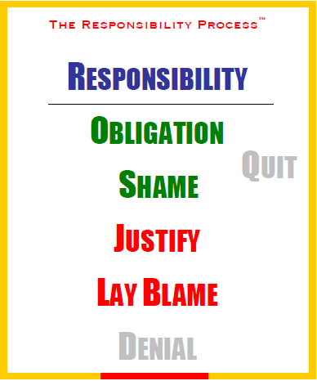
Source: christopheravery.com

Slide 12
Be confident

Slide 13
Bullies

Slide 14
You are responsible for your life and career

Slide 15
"Don't ask yourself what the world needs. Ask yourself what makes you come alive and then go do that. Because what the world needs is people who have come alive.”
-- Howard Thurman

Slide 16

Resources
Leon Gersing – “You”
google: “leon gersing you keynote”
http://www.davidgiard.com/2012/05/11/GANG10KeynoteLeonGersingOnYou.aspx

Slide 17
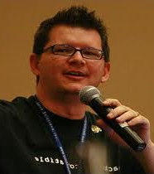
Resources
Brian Prince – “Driving Your Career”
google: “Brian Prince driving”
http://www.msdnevents.com/thrivedev/DriveCareer/

Slide 18

Resources
Good to Great, by Jim Collins

Slide 19
Thanks!
Slides, code, links:
http://jonkruger.com/,
click on Presentations
Email: jon@jonkruger.com
Twitter: @JonKruger
Blog: http://jonkruger.com

